Slide 1

PUBLICATION TALK
Publish with high impact journals
LOKMAN MOHD TAHIR
The School of Education
Faculty of Social Sciences and Humanities
Universiti Teknologi Malaysia
UTM JOHOR BAHRU

Slide 2
Why we need to publish papers?
There are many reasons why academia/research students/post doctorate publish their papers:

Slide 3


Slide 4

“telling others”

Slide 5
Yearly performance
Performance indicators

Slide 6
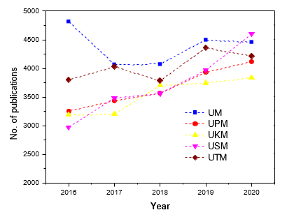
Comparing the RUs (Mohd Saridjan & Md Kassim,2023)

Slide 7
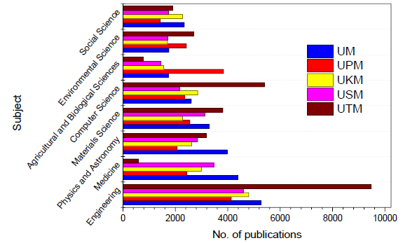
Publications based on subjects

Slide 8
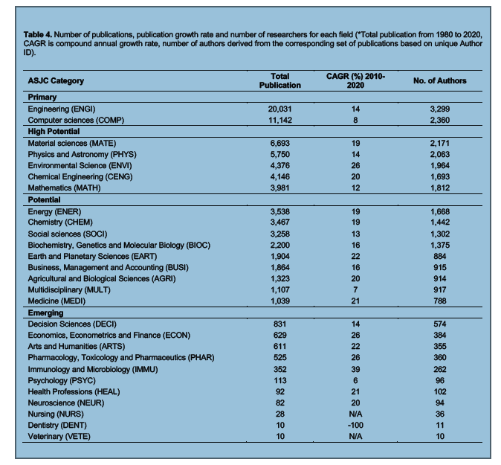
UTM’s case study

Slide 9
Preparing your journal manuscript

Slide 10
For submission for non-paid journal
For SSCI not for multi-disciplinary and SCI journals.
Specifically meant for social sciences and humanities

Slide 11
Phase 1 : Preparation

Slide 12
Questions to ask before prepare your manuscript (Bonja, 2017)
think why you should publish your manuscript? Whether its publishable?
Is it something new or interesting?
Is it related to hot/interest topics?
What solutions that I might contribute with this paper?
Decision on the types of journal? Scopus or ISI?

Slide 13
Are you ready to publish?
Outdated work
Original results or methods
Incorrect conclusions
Significant enhancement of published work
Duplication of published work
Up-to-date review of a subject or field
Not ready
Work has no scientific interest
Ready
Work advances the field
Notes:
Firstly you need to critically assess if you are really ready to publish.
As a rule of thumb, you SHOULD only consider publishing your research if you have information that advances the understanding in a specific research field. This could take the form of:
-Presenting new, original results or methods
-Rationalizing, refining, or reinterpreting published results
-Reviewing or summarizing a particular subject or field
If these criteria are met, you’ll need a strong manuscript to effectively present your contributions to the scientific community.

Slide 14
Self-reviewers checklist
Contains any sufficient new material to be shared?
Is it presented wisely and neatly
Is the methodology sound or for lower level of article?
Are the discussion concise and relevant
Is the language acceptable

Slide 15
Choosing the target journal
Send your article to one journal only
Read the recent publications /volume that related to your targeted journal
Understand the previous published article
Find out whether your topics/title able to be published in the relevant journal
Find out on the journal’s preferences.

Slide 16

The preparation phase
Q1 in Education and Educational Research
IF 3.512
Select a journal that represented your area of expertise.
Identify the acceptance rate
Read papers from that journal

Slide 17
Things to consider
Words count : 6000 – 8000 words
Areas of study
Avoid plagiarism: write with your own words and supported by your readings
Acceptance rate (very important)
Send your manuscript based on your own capacity. Scopus? ISI?
Familiar with the journal’s format
Proofreading your article?

Slide 18
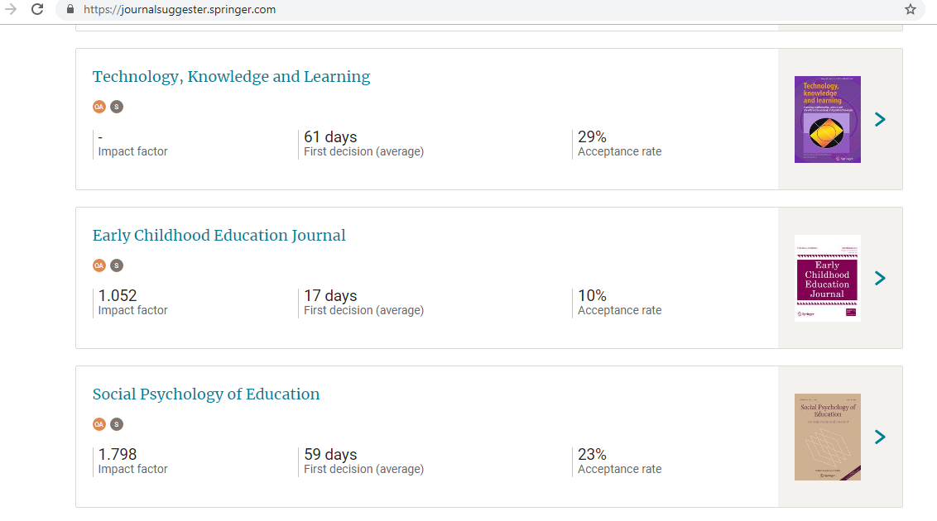

Slide 19
Determine the journal’s word count limitation
Usually journal insisted the initial submission between 6,000 to 8,000 words. Depends on the editorial board.
Failure to follow the relevant guideline submission will resulted with desk rejections
Manuscripts which have been rejected usually difficult to be re-submit for the second time.

Slide 20
What is desk rejection?
Submitted manuscript which:
(a) exceeds the word limits
(b) low standard
(c) not the journal’s focus/ re-focusing of the
journal’s contents.
(d) the author[s] many published papers in
the previous volumes.

Slide 21
Things to consider in submitting manuscript
The acceptance rate
The journal methodologies preferences (Quanti vs quali vs mixed methods)
The editorial members and editor-in-chief
Local authors published in that journal
The new findings to be shared

Slide 22
What actually happens
Notes:
It actually works like this:
First the editor or editorial office check that your paper meets the fundamental requirements for the journal which may include considerations such as the scope, novelty, ethics, English language quality and so on. If your paper does not meet these requirements then your paper will be desk rejected.
If your paper does meet these requirements, your paper will be sent for review. The reviewers are selected by the editor as experts in the topic(s) covered by the paper, and usually editors seek 2 reviews for each manuscript.
Reviewers give recommendations but the decision is ultimately the editor’s. The editor may decide that your paper should be accepted without revision, although this is very rare, rejected, or revised.
If your paper is to be revised, when the revision is resubmitted the paper may or may not undergo further rounds of review.
The length of time this process takes depends on the field and the journal. Editors and journal managers try to accelerate this process as much as possible, by uninviting reviewers that don’t agree to review within a short window of 10-14 days, by setting ambitious deadlines for reviewers to submit their reports (28 days is common) and by reminding reviewers, both as they approach the deadline to submit their report and when they are late.
Source: Michael Derntl. Basics of Research Paper Writing and Publishing. http://www.pri.univie.ac.at/~derntl/papers/meth-se.pdf

Slide 23
Phase 2 : Preparing your manuscript

Slide 24
Title of the manuscript
Normally around 15 WORDS!
Brief (short & sharp) phrase
describing/reflecting the contents of the paper.
Concise and informative.
Be specific
Avoid abbreviations, prepositions and formulae where possible
Question title?

Slide 25
  Should identify the main issue of the paper
  Should be concise
  But also accurate, unambiguous, specific, and complete
  Should use professional language and avoid rarely-used abbreviations
  Will attract readers - short, catchy titles are often better cited

Slide 26


Slide 27


Slide 28
Abstract
Keep it as brief as possible
Summarize the problem, methods, results, and conclusions
Make sure it is clearly written and easy to understand
Make sure it is accurate and specific while also being catchy
Write last so accurately reflects the content of the paper
Notes:
If the title catches a reader’s attention, the next thing a potential reader will look at is the Abstract which is always freely available in electronic abstracting and indexing services, such as Web of Science, PubMed, Medline, Embase, and Scopus.
The Abstract should be as brief as possible - a single paragraph is sufficient.
The Abstract should summarize the problem, the methods, the results, and the conclusions.
Consider your writing style - an abstract that is clearly written and easy to understand will strongly encourage the reader to read the rest of your paper.
Think of the abstract as the advertisement for your article since it is freely available via online searching and indexing – make sure it is accurate and specific but also catchy.
Take the time to write the Abstract very carefully. Many authors write the Abstract last so that it accurately reflects the content of the paper.

Slide 29
Introduction
First Stage:
Begin with general statements about a field of
research to provide the reader with a setting for
the problem to be reported.
Up to date literatures.
Please discuss on the importance of the topic towards society, school effectiveness etc..

Slide 30
Use significant phrases such as:
Topic A has long debated history among previous researchers…
More recent attention has focused on the importance of topic A to…
A large number and growing body of literature/ studies on A…

Slide 31
Second Stage:
More specific statements about
the aspects of the problem already studied by other researchers.

Slide 32
Reports on current previous studies within the same topic..
exp:
Jones et al (2014) reports on…
In 2013, Hamidiar revealed that…
One recent study by McGraw (2010)…
In comprehensive study by Ahmad (2011)
revealed that…
Prove that this topic is a relevant topic to examined, explored or investigate..

Slide 33
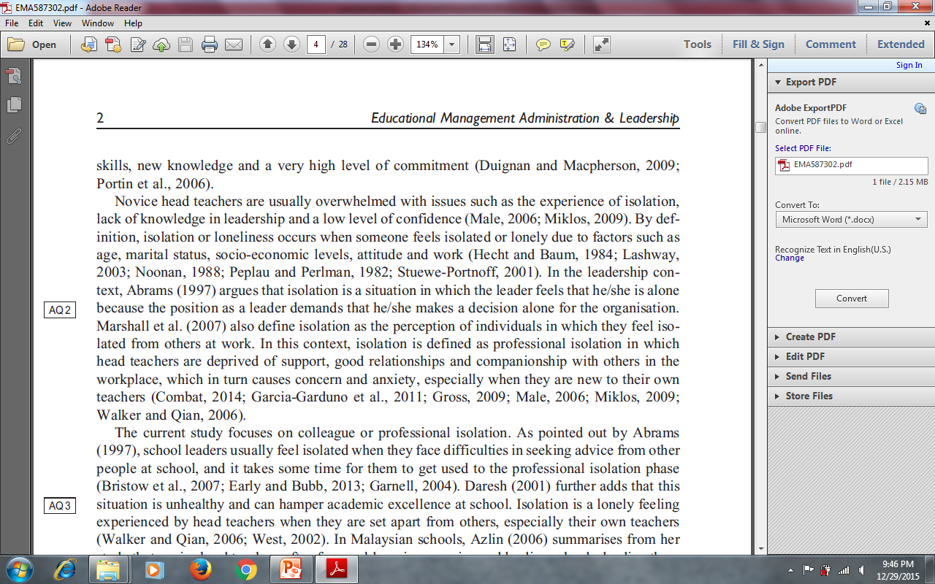
The literature on the relevant topic

Slide 34
Third Stage:
Statements that indicate the need for more investigation. (Research gap/novelty of the study)

Slide 35
Examples
Used some phrases such as:
To date, only a few studies that investigate the prevalence of the current issues…
Currently, studies that related to the findings are considered very limited..
There is little published data on…

Slide 37
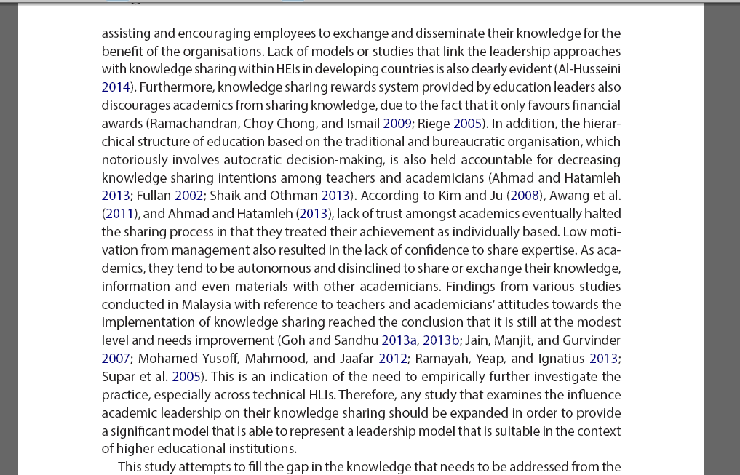
The research gap

Slide 38
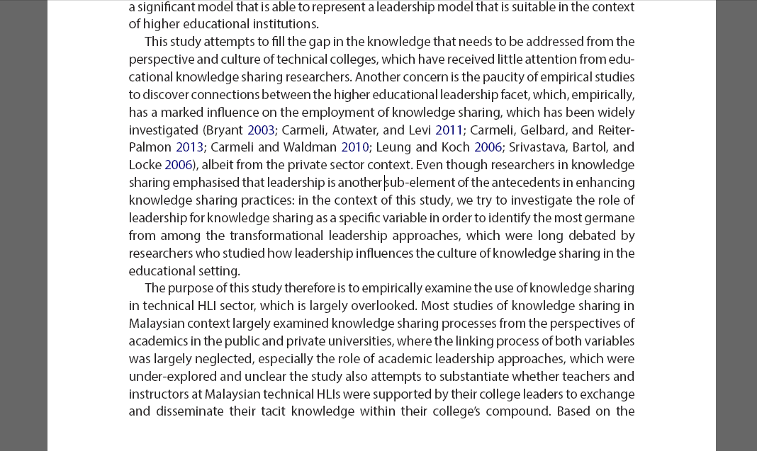
Continue with the research gap and start with the objective of the study

Slide 39
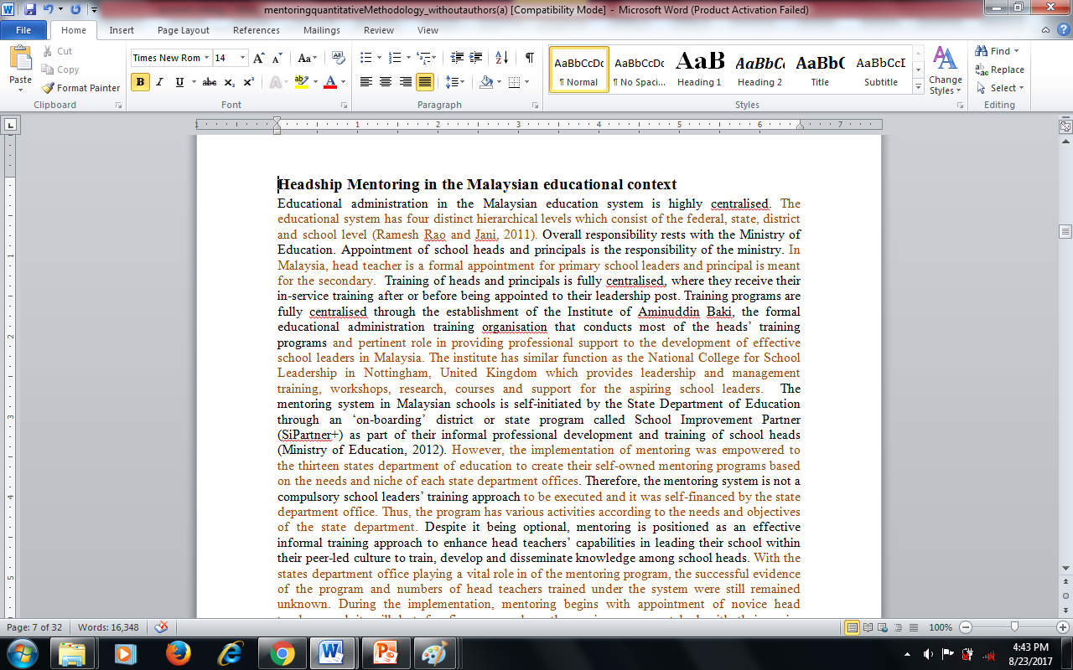
The location context

Slide 40
Fourth Stage:
Very specific statements giving the purpose/objectives of the writer’s study.

Slide 41
Examples
The objective of this paper is to…
The aim of this paper is to…
This paper is seeks to address the following research questions…

Slide 42
Fifth stage:
Significant of the study.
(please highlight your significant of your study through a few approaches;

Slide 43
Highlighted your contributions of reason why your paper to be considered:
It’s a new knowledge to be discovered within your scope of the context…
What it remains or left unknown by previous researchers… yet the objective of your paper is to fill the gap..

Slide 44

Provide critics to previous papers within the same scope from various methodology perspectives: samples, location of the study, design.. etc

Slide 45
Examples
The findings of the study will help…
The results will fill the gap that were left by previous researchers on…

Slide 46
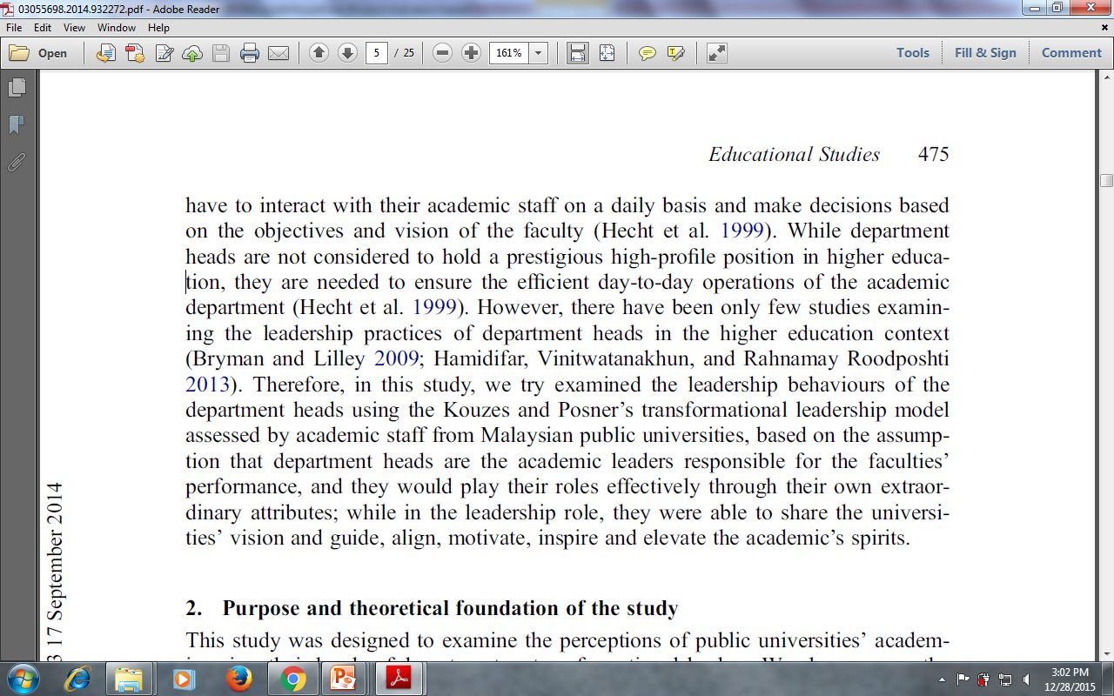
The research/study gap

Slide 47
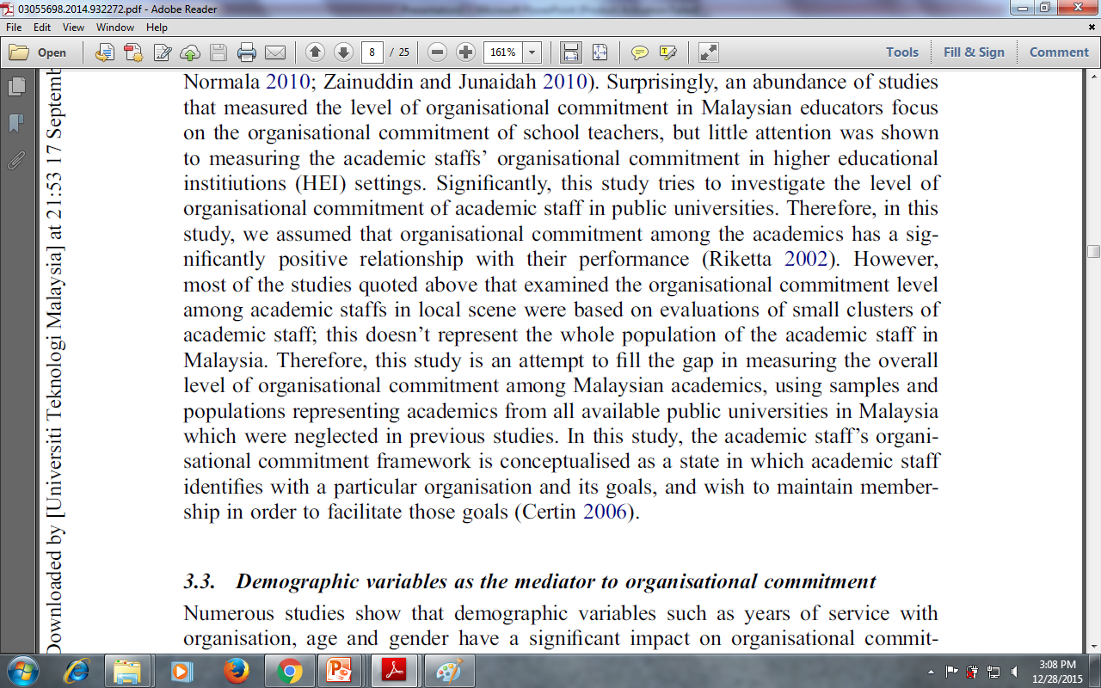
Critics on others’ research sample

Slide 48
Last stage:
Please state either your research objectives or research questions.
One or Two RQ/RO will do.
Please don’t list all your RQ/RO and your paper will be lengthy which sometimes not interested to be reviewed.

Slide 49
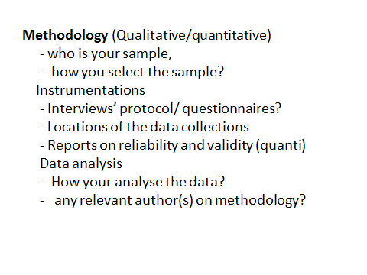

Slide 50
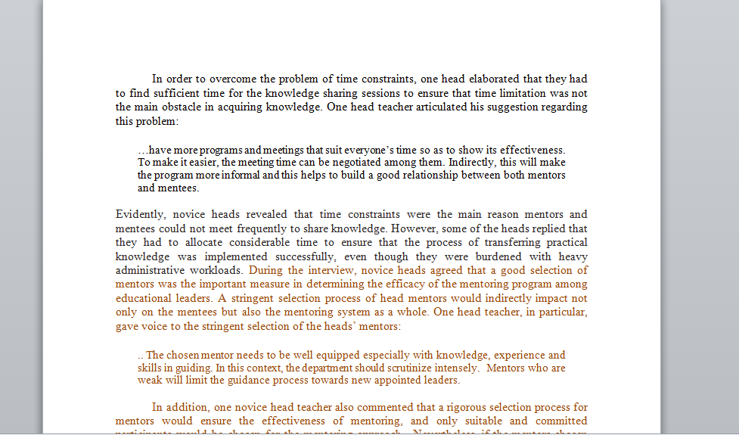
Qualitative finding

Slide 51
Discussion and conclusions

Slide 52
Results and discussions section is the most important part of the manuscript in which critical analysis of the results are done.
Any limitations of the results presented or techniques used in the study are to be highlighted in this section.

Slide 54
Reference to previous research:
… these results support the idea of…
….these findings confirm the previous studies by….

Slide 55
Unexpected significant outcomes:
Please reports on significant or new findings that might some impact or implications on the body of knowledge…
Exp..
Significantly, …..
Surprisingly, ....

Slide 56
Implications and suggestions:
To policy, training methods, selection, system or procedures …
To improve your methodology constraints…
Limitations of your study…

Slide 57
Conclusion
This section should re-inforce the originality of the work presented.
Looks back at your objective and highlight your significant finding.
Please restatements of the paper’s aims..
exp…
This paper has argued that….
In this investigation, we assess…

Slide 58
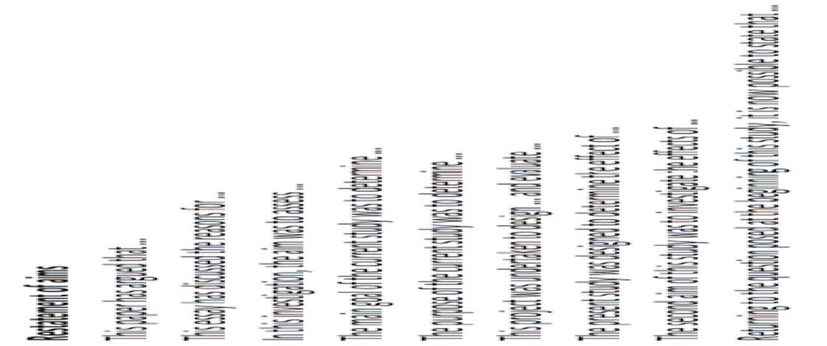
Preparing your conclusion

Slide 59
Summary of research findings

Slide 60
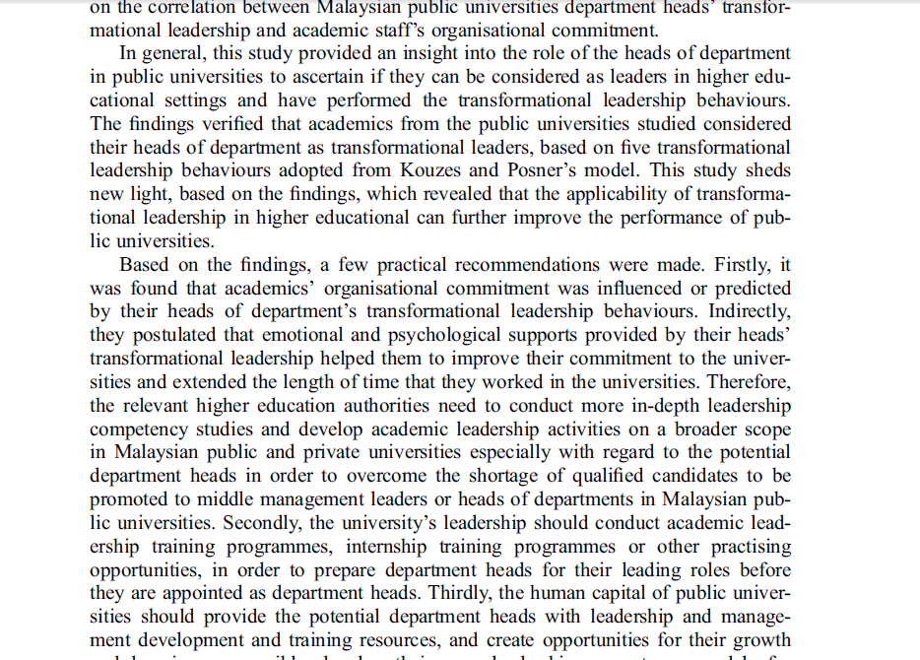
Some suggestions on practical implications on policy and training..

Slide 61
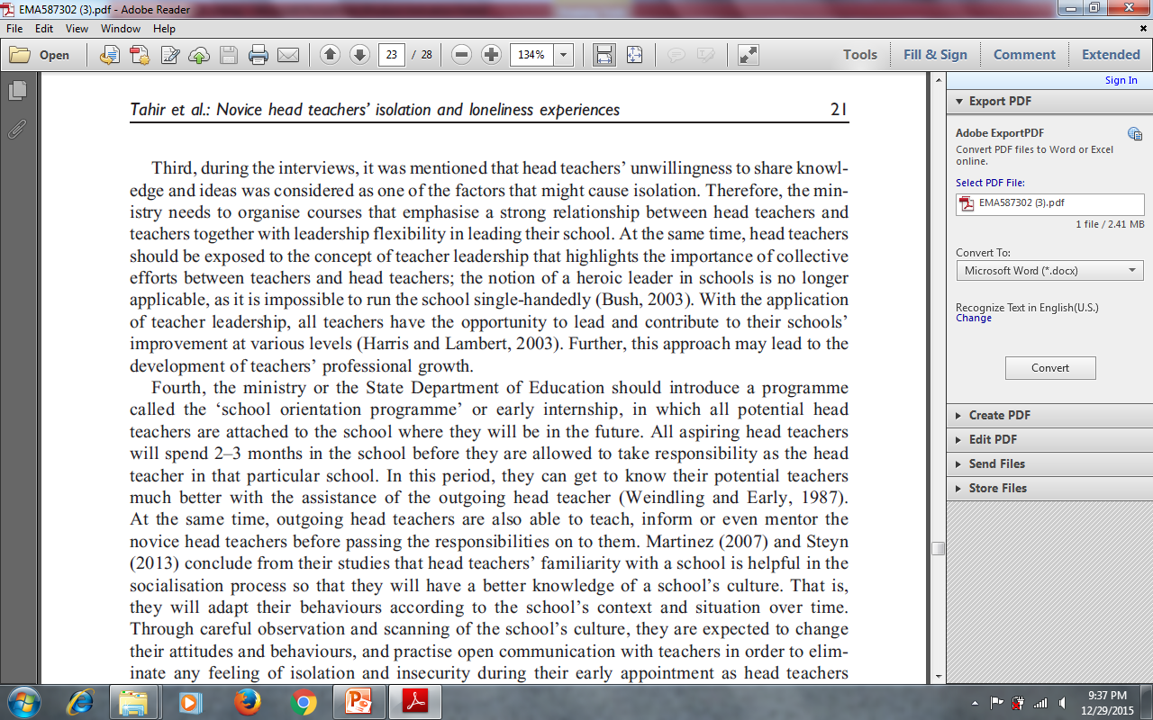
Provide literature to support your arguments/suggestions

Slide 62
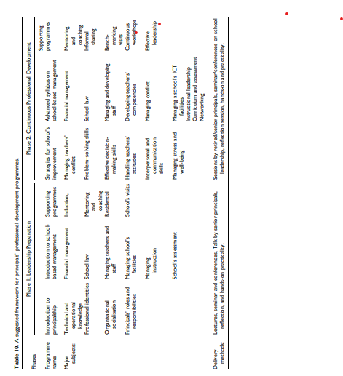
The study’s suggested framework

Slide 63
Phase 3 : Reading your paper and send to the relevant proofreader

Slide 64
Depending on the quality of the journal.
Have the paper read by several people. Listen to what they say, especially if same criticism comes up several times. Check and recheck spelling, figures, references, legends etc .
Reviewers can be really annoyed by careless editing and mistakes that can reflect badly on the authors.
Preference given to the native speaker which to some considered as costly.
Problem on the language and grammatical aspects really disturbing reviewers evaluation on your paper

Slide 65
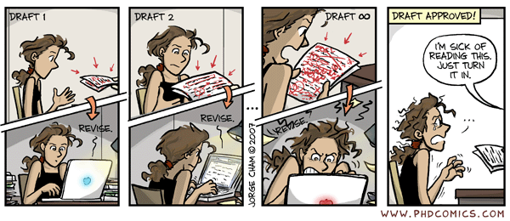
Revise before submission
Notes:
The best advise I can give it to check your paper over and over again to ensure it is vetted as thoroughly as possible before submission. Of course all authors should check and approve the manuscript but you might also ask colleagues and supervisors to review your manuscript for you. If you don’t do this before submission you’ll have to do it during revision, so it’s better to do it upfront and send the editor and reviewers the best possible first impression.

Slide 66
Phase 4 : Submitting your paper

Slide 67
Where to submit?
Scope of Journal
ISI/Scopus Indexed
Journal Format
Publication frequency
Publication history

Slide 68
What do Editors want?
Excitement/ “wow”
Importance
Originality
Relevance to the audience
True
Clearly written

Slide 69
Review Process
• It may take from 1 week to 3 years
• One to 3 reviewers along with editorial comments
• Some journals editors assess submission and provide decisions if no new contributions
• Accept/reject/revise
• Proof preparation for checking by authors
• Corrections by production dept.
• In press/queue/article in press
• Completion (vol, issue, page number, year):

Slide 70
Typical first decisions
Revisions are nearly always requested
DECISION TYPES
  Desk reject
  Reject after review
  Major revisions required
  Conditional accept with minor revisions
  Accept without change – extremely rare

Slide 71
Decision
Be prepared for rejection and don’t take it too hard.
Remember that only very few papers are immediately accepted.
Resubmit your paper if the journal wanted to accept it with changes. Alternatively, if the journal rejects it, send it to another journal.

Slide 72
Replying to the reviewers
Referee: 1
Comments to the Author
In my last comment regarding the level of stress among genders, the findings were very vague due to no statistical data as evidence to underpin that statement. (The finding showed that female deputies experienced slightly higher levels of stress when dealing with SDE/DDE, their heads and also parents. However, male deputies experienced slightly higher levels of stress compared to their female deputies when dealing with the school inspector.) After the third revision, the authors emphasized that the findings were related to to deputies’ experiences of stress (P12 L20-27, you stated that “the pertinent issue of this study is related to deputies’ experiences of stress when dealing with their superiors and stakeholders. Generally, based on the feedback from the deputies, it could be seen that deputies do experience stress when dealing with their superiors; however, it was revealed that the deputies were experiencing low stress levels when dealing with parents, officers from SDE and DDE, and their own school heads, but their stress was indicated to be at relatively stressful when dealing with the school inspector.”)
However, the question here is how do you measure the levels of stress if you are using qualitative from the feedback of the respondents. Anyway, you just need to explain and clarify how you categorized as high or low via qualitative analysis in your analysis section.
Reply: Thank you very much for your concern. The level of stress among deputy heads was measured using the Table 2 and later Table3 which is based on the frequencies on deputies’ stress. In the initial submission, the level of stress was measured based on numbers of frequencies and later improved with mean scores and standard deviations in categorizing the high and low levels. Therefore, it isn’t based on the qualitative findings.
Referee: 2
Comments to the Author
1.Title of the paper is differ from the focus of the content as well as the keywords which is on “leadership” . I suggest the title change from “ Management” to “ Leadership” .
2.All the direct quotations for the Qualitative findings should have identity code (page 17-20).
3.Some of the References in the text is not consistent. For example: some used “and “ for the reference in bracket ( page1/line 39), and some used “&” (page 1/line 45), etc.
Reply: Thank you very much for your suggestions . I will ensure that all corrections are made based accordingly

Slide 73

Handling rejection
Read the referees’ report and the Editor’s letter
Focus on why
Try and re-work the paper
Consider submitting to an
alternative journal

Slide 74
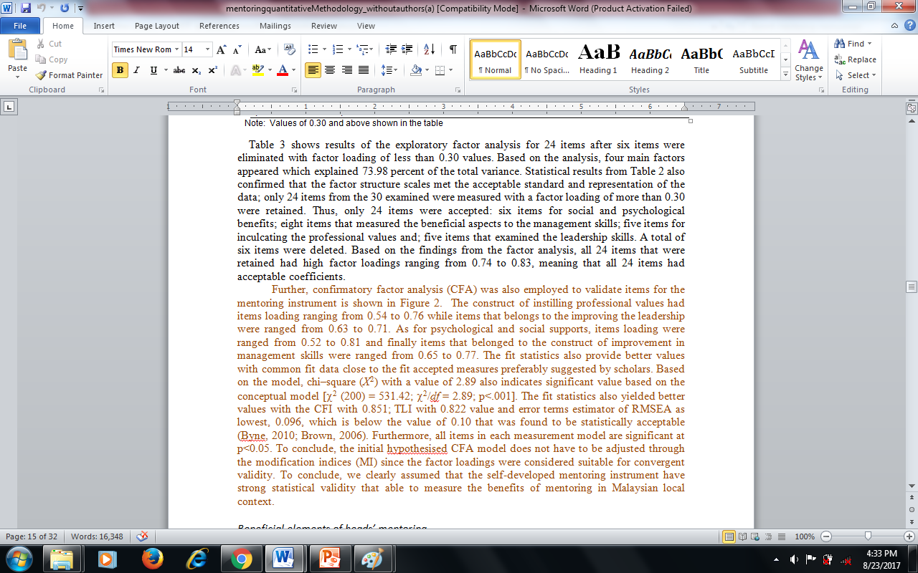

Slide 75
Many thanks

